Slide 1
VLAN的通信

Slide 2
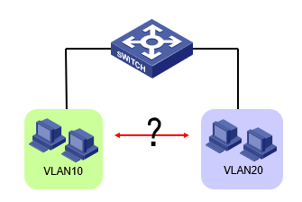
VLAN间的通信需求

Slide 3
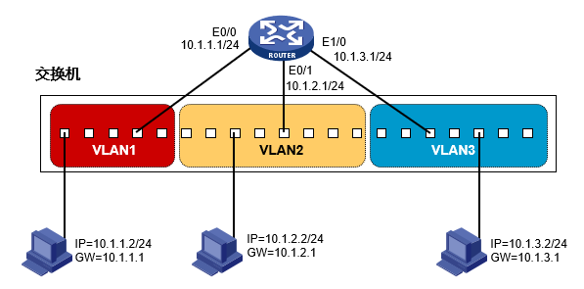
路由器实现VLAN间通信
路由器端口的数量问题？

Slide 4
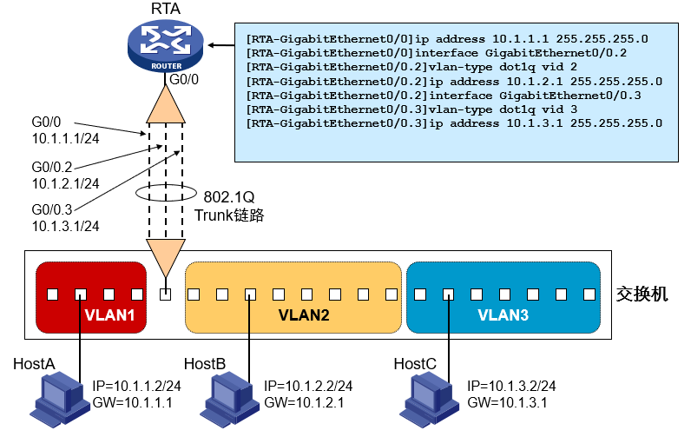
单臂路由
利用802.1Q和子接口实现
存在的问题？

Slide 5
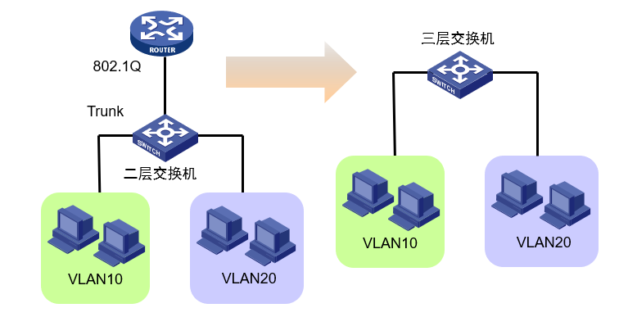
三层交换机的产生
二层交换和三层路由的集成

Slide 6
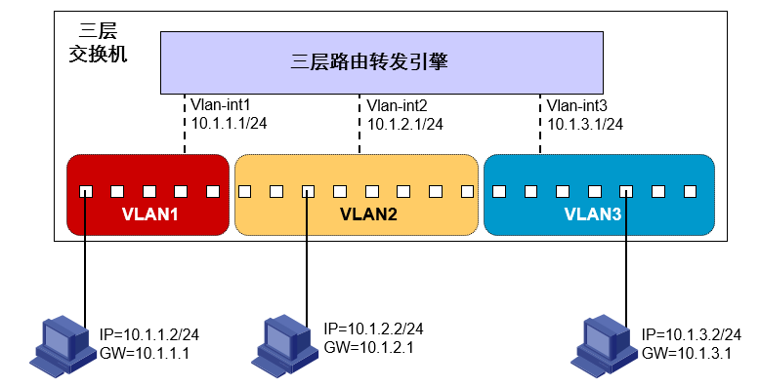
利用三层交换机实现VLAN间通信
三层路由转发引擎

Slide 7
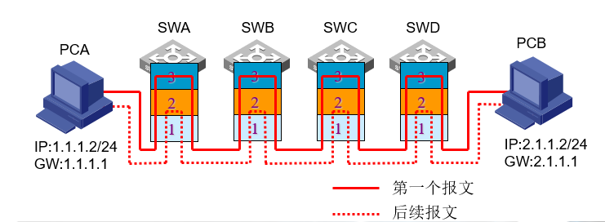
交换机匹配转发模型
CPU维护路由表
ASIC芯片完成主要的数据转发
一次路由，多次交换

Slide 8
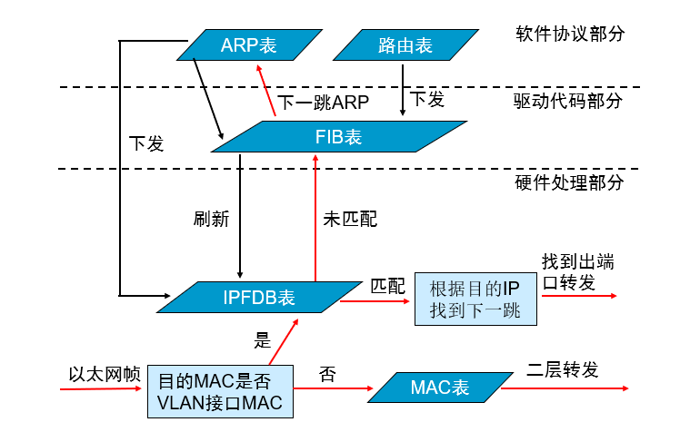
交换机转发表

Slide 9
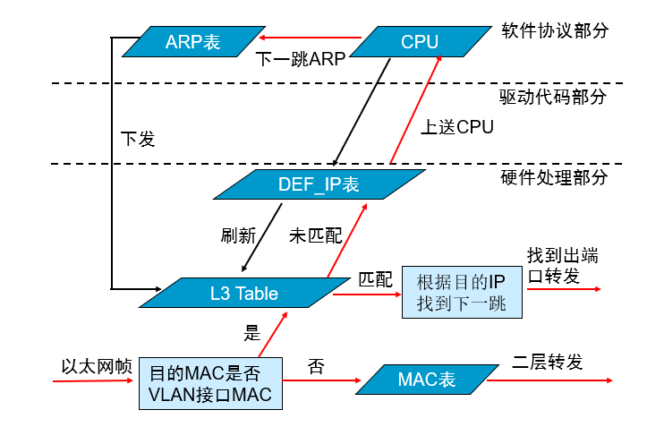
交换机最长匹配转发表

Slide 10
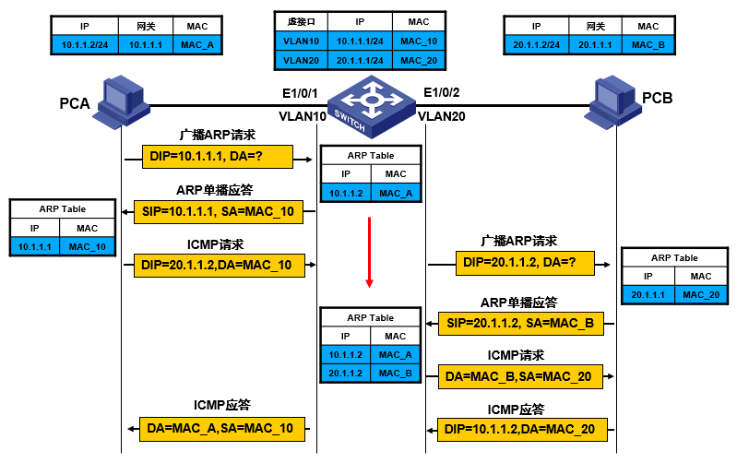
直连VLAN间流量转发

Slide 11
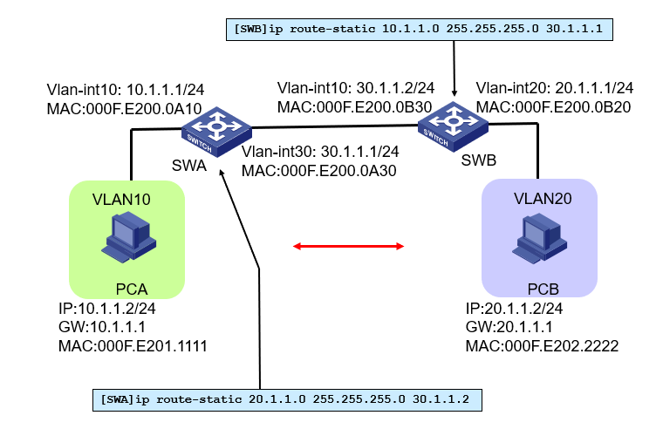
跨设备VLAN间流量转发

Slide 12
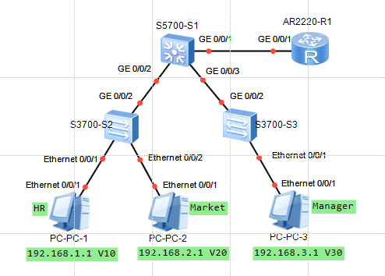
单臂路由案例
S1
vlan batch 10 20 30
interface GigabitEthernet0/0/1
port link-type trunk
port trunk allow-pass vlan 2 to 4094
#
interface GigabitEthernet0/0/2
port link-type trunk
port trunk allow-pass vlan 2 to 4094
#
interface GigabitEthernet0/0/3
port link-type trunk
port trunk allow-pass vlan 2 to 4094

Slide 13
单臂路由案例
S2
vlan batch 10 20
#
interface Ethernet0/0/1
port link-type access
port default vlan 10
#
interface Ethernet0/0/2
port link-type access
port default vlan 20
interface GigabitEthernet0/0/2
port link-type trunk
port trunk allow-pass vlan 2 to 4094

Slide 14
单臂路由案例
S3
vlan batch 30
#
interface Ethernet0/0/1
port link-type access
port default vlan 30
#
interface GigabitEthernet0/0/2
port link-type trunk
port trunk allow-pass vlan 2 to 4094

Slide 15
单臂路由案例
R
interface GigabitEthernet0/0/1.1
dot1q termination vid 10
ip address 10.1.1.254 255.255.255.0
arp broadcast enable
#
interface GigabitEthernet0/0/1.2
dot1q termination vid 20
ip address 20.1.1.254 255.255.255.0
arp broadcast enable
#
interface GigabitEthernet0/0/1.3
dot1q termination vid 30
ip address 30.1.1.254 255.255.255.0
arp broadcast enable

Slide 16
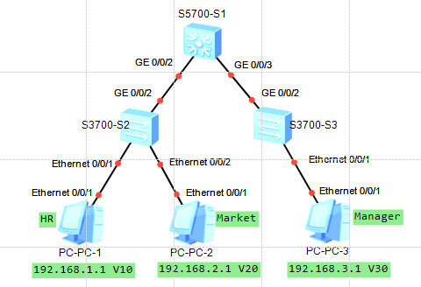
三层交换机案例
S2
vlan batch 10 20
#
interface Ethernet0/0/1
port link-type access
port default vlan 10
#
interface Ethernet0/0/2
port link-type access
port default vlan 20
interface GigabitEthernet0/0/2
port link-type trunk
port trunk allow-pass vlan 2 to 4094

Slide 17
三层交换机案例
S3
vlan batch 30
#
interface Ethernet0/0/1
port link-type access
port default vlan 30
#
interface GigabitEthernet0/0/2
port link-type trunk
port trunk allow-pass vlan 2 to 4094

Slide 18
三层交换机案例
S1
vlan batch 10 20 30
interface Vlanif10
ip address 192.168.1.254 255.255.255.0
interface Vlanif20
ip address 192.168.2.254 255.255.255.0
interface Vlanif30
ip address 192.168.3.254 255.255.255.0
interface GigabitEthernet0/0/2
port link-type trunk
port trunk allow-pass vlan 2 to 4094
interface GigabitEthernet0/0/3
port link-type trunk
port trunk allow-pass vlan 2 to 4094

